Slide 1
RECAP

Slide 2
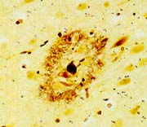
Origin of the β-amyloid plaque
The β-Amyloid Plaque
Aβ oligomers
Aβ
40/42/43
proteolysis
APP
TMD
NH2
COOH
amyloidogenic processing pathway
Mechanisms of Aβ pathology:
Plaque: unknown
Aβ: oligomers affect synaptic activity and neurotransmitter release

Slide 3
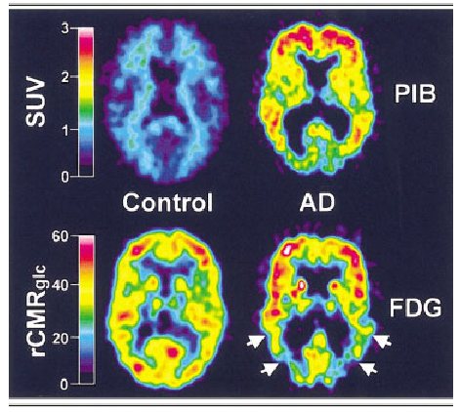
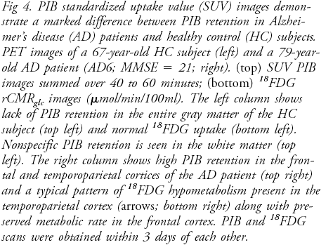
The Pittsburgh Compound B PIB is
specifically up-taken in AD brains

Slide 4
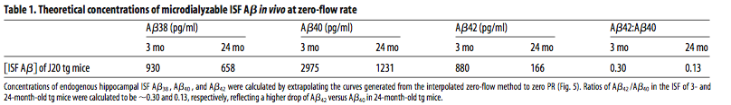
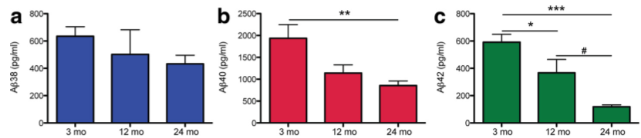
Levels of soluble ISF Abeta decrease with disease progressing…

Slide 5
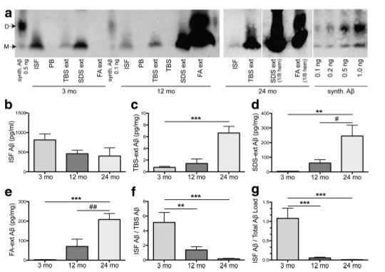
…whereas levels of insoluble Abeta increase

Slide 6
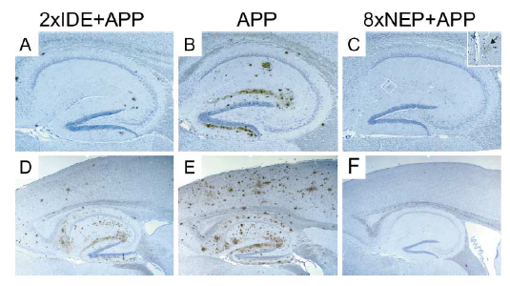
Decreased Aβ plaque burden in animals overexpressing
Insulin Degrading Enzyme (IDE) and Neprilysin
Leissring et al.,

Slide 7
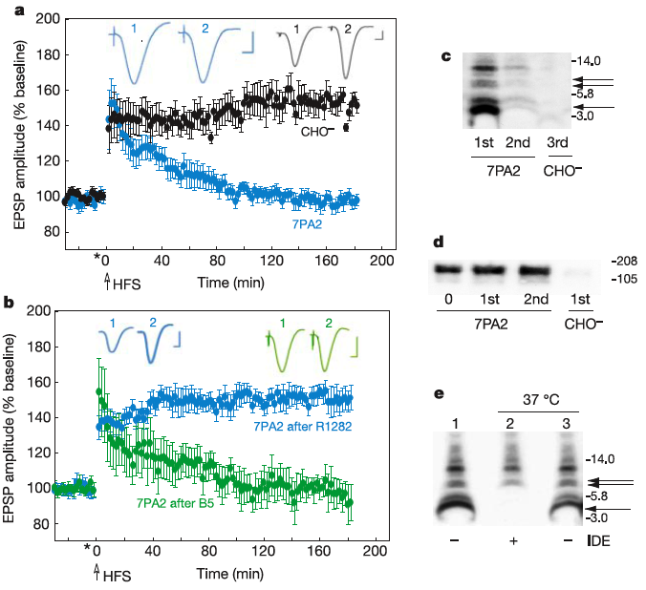
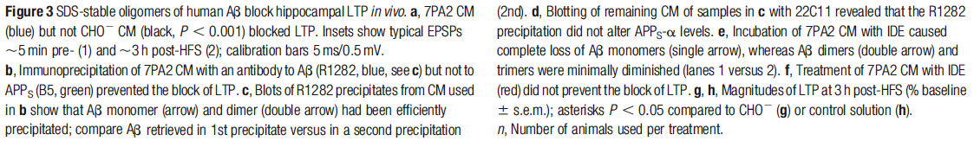
Aβ Oligomers block LTP in vivo
This effect can be reverted in presence of specific Aβ oligomer antibody

Slide 8
Is there anything we can do to help the system get rid of the plaques?
Y E S ! H E A L T H Y L I F E S T Y L E !!

Slide 9
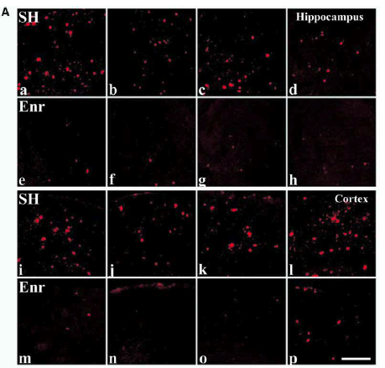
Abeta plaques are reduced in APPTg mice in enriched environment

Slide 10
Processing of APP
α-secretase
β-secretase
APP
TMD
NH2
COOH
sαAPPs
C83
C99
sβAPPs
γ-secretase
γ-secretase
Aβ
AICD
p3
AICD
Protective
non-amyloidogenic
pathway
Pathogenic
amyloidogenic
pathway

Slide 11
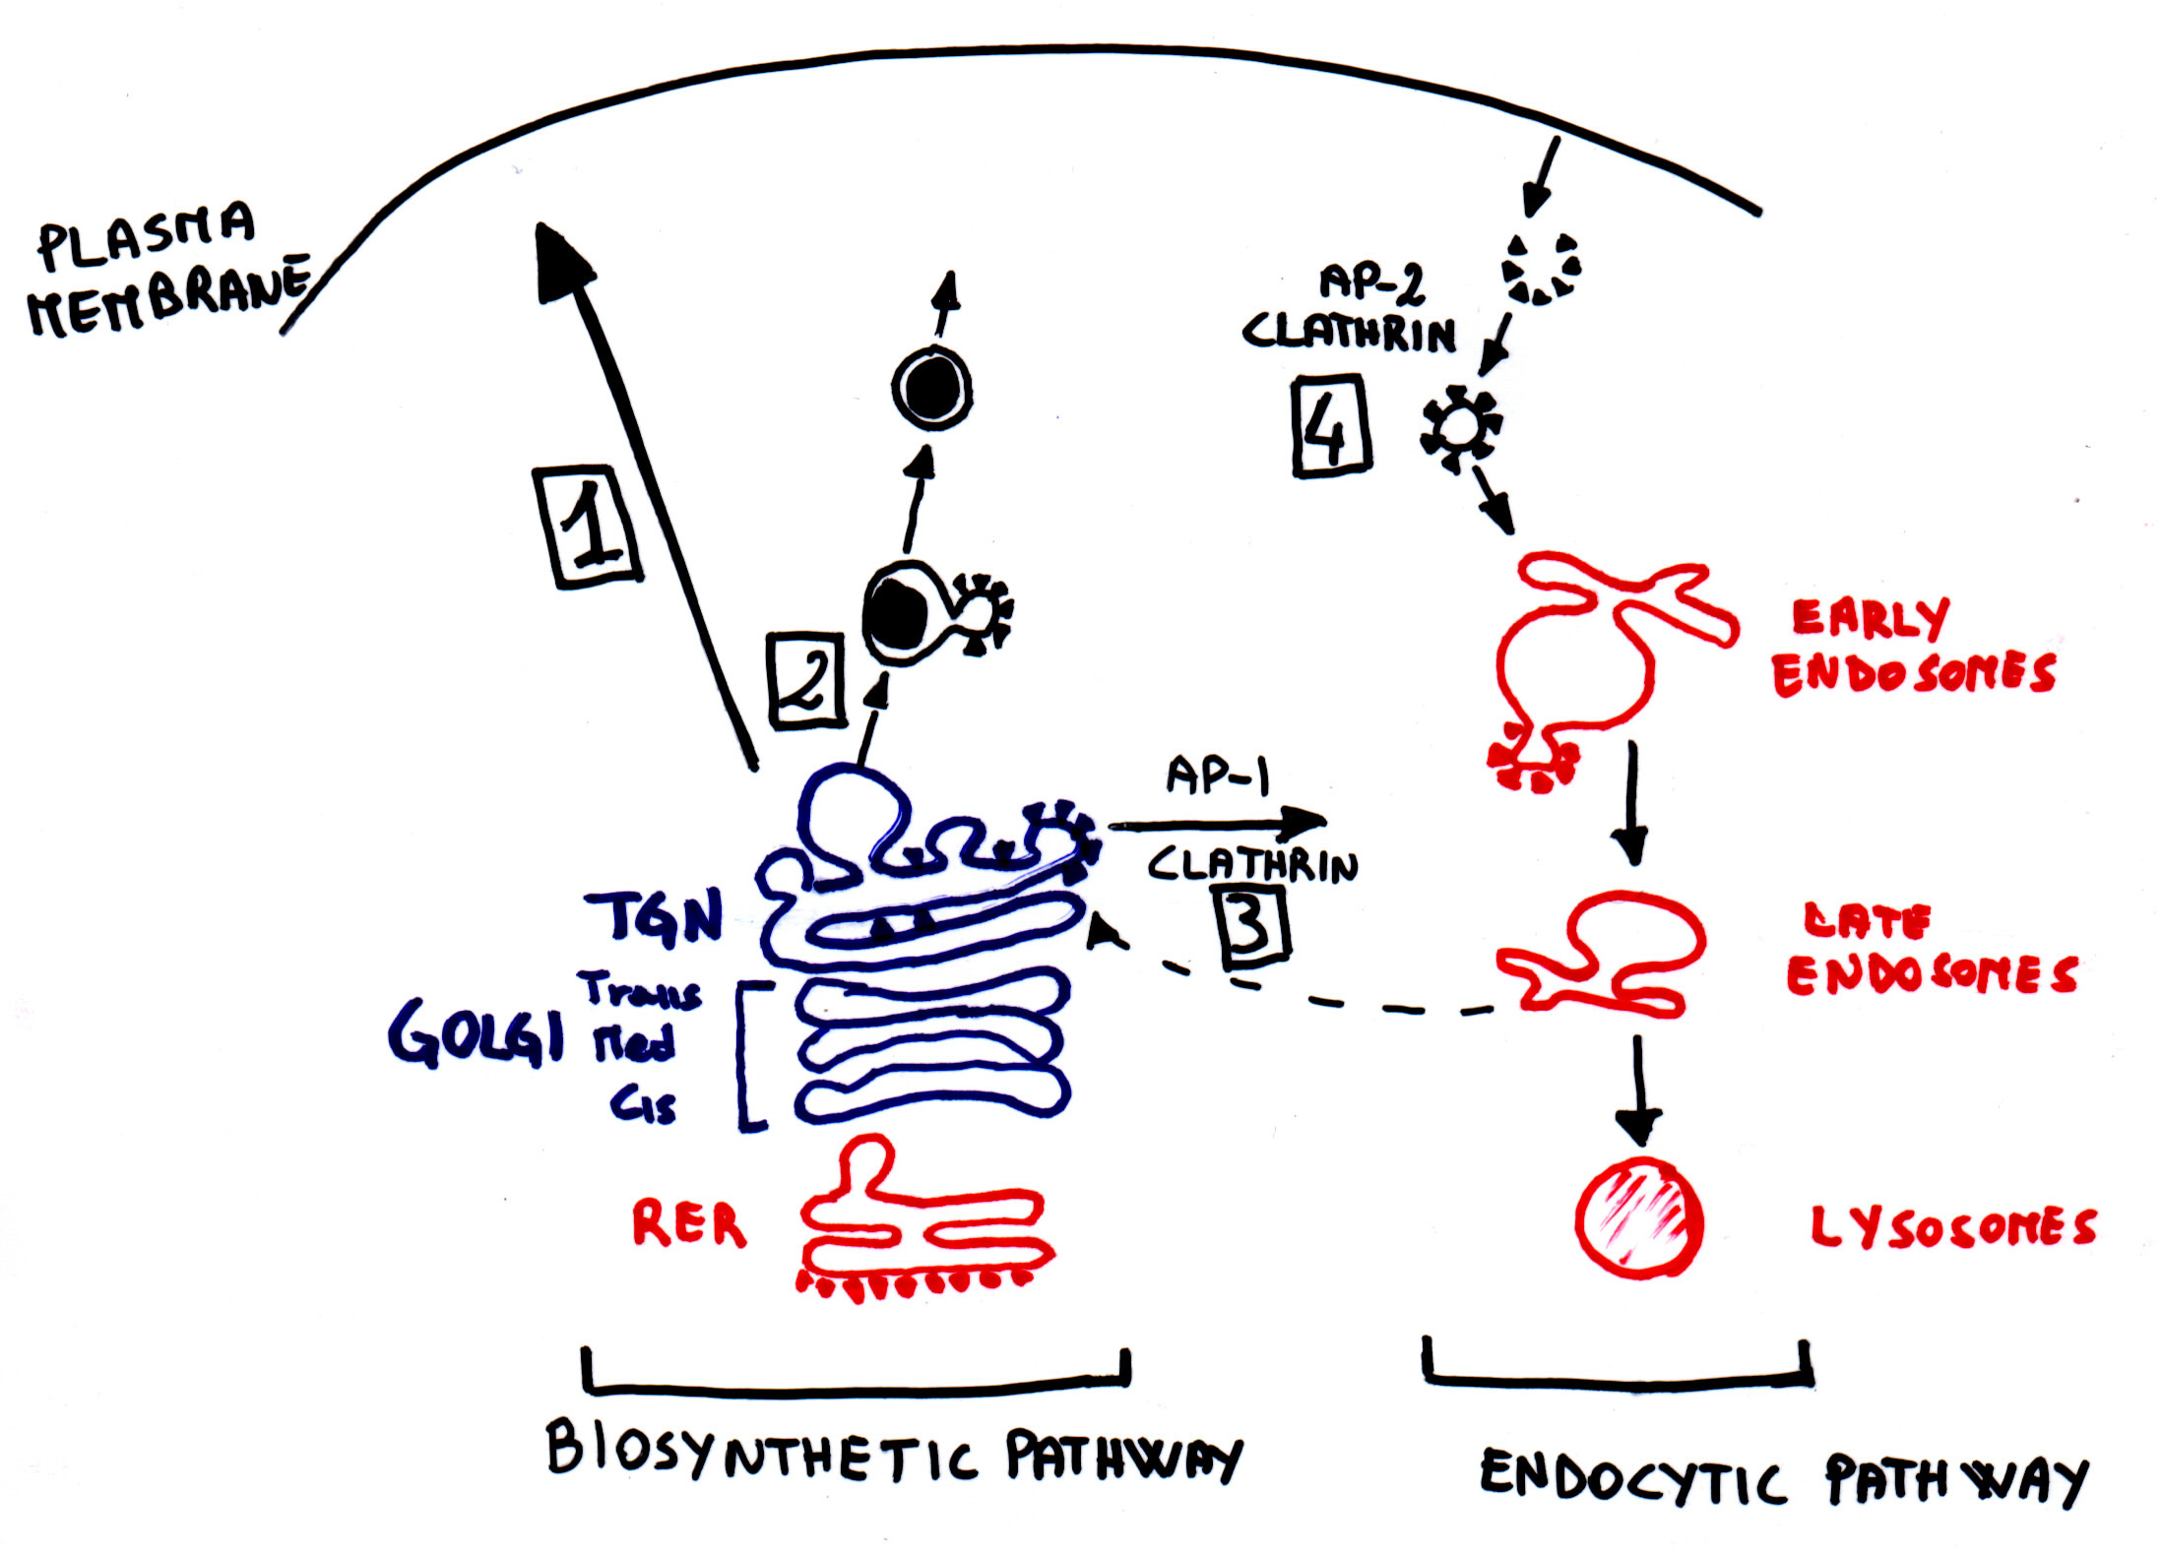
Trafficking of APP
APP
αAPP
α-secretase activity
APP
C83
β-secretase activity
C99
βAPPs
C99
AICD
γ-secretase activity
Aβ

Slide 12
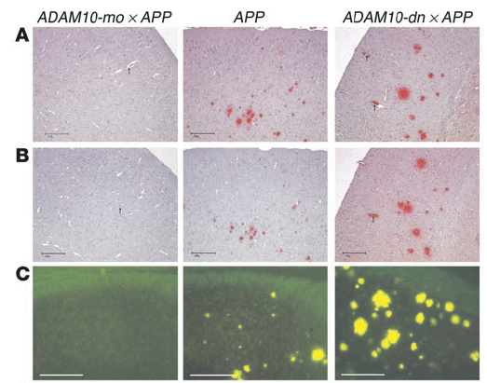
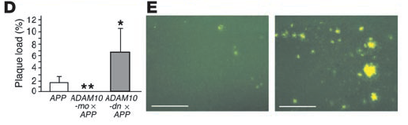
ADAM10 protects from plaque deposition
in APPTg V717I (Indiana) mice…
10 months old

Slide 13
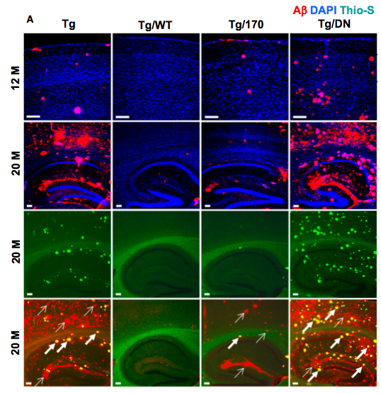
ADAM 10 LOAD mutations affect plaque deposition in AD mice

Slide 14
BACE Domains and trafficking
1
aa460-476
501
Propeptide
sequence
DTG
DSG
TM
furin
DDISLLK
Regulation of BACE Trafficking
Abeta?

Slide 15
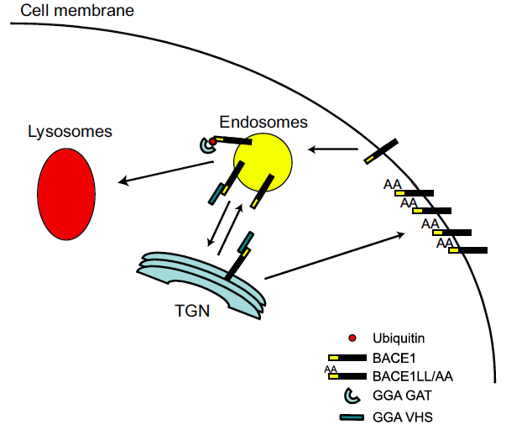
GGA proteins: a crucial role in the regulation
of BACE trafficking and degradation through BACE LL domain

Slide 16
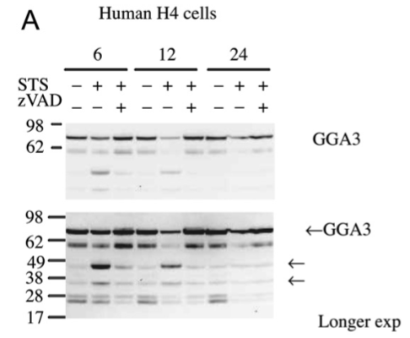
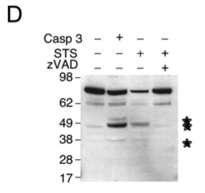
During apoptosis GGA3 levels are destabilized
Tesco et al., Neuron. 2007 Jun 7;54(5):721-37.

Slide 17
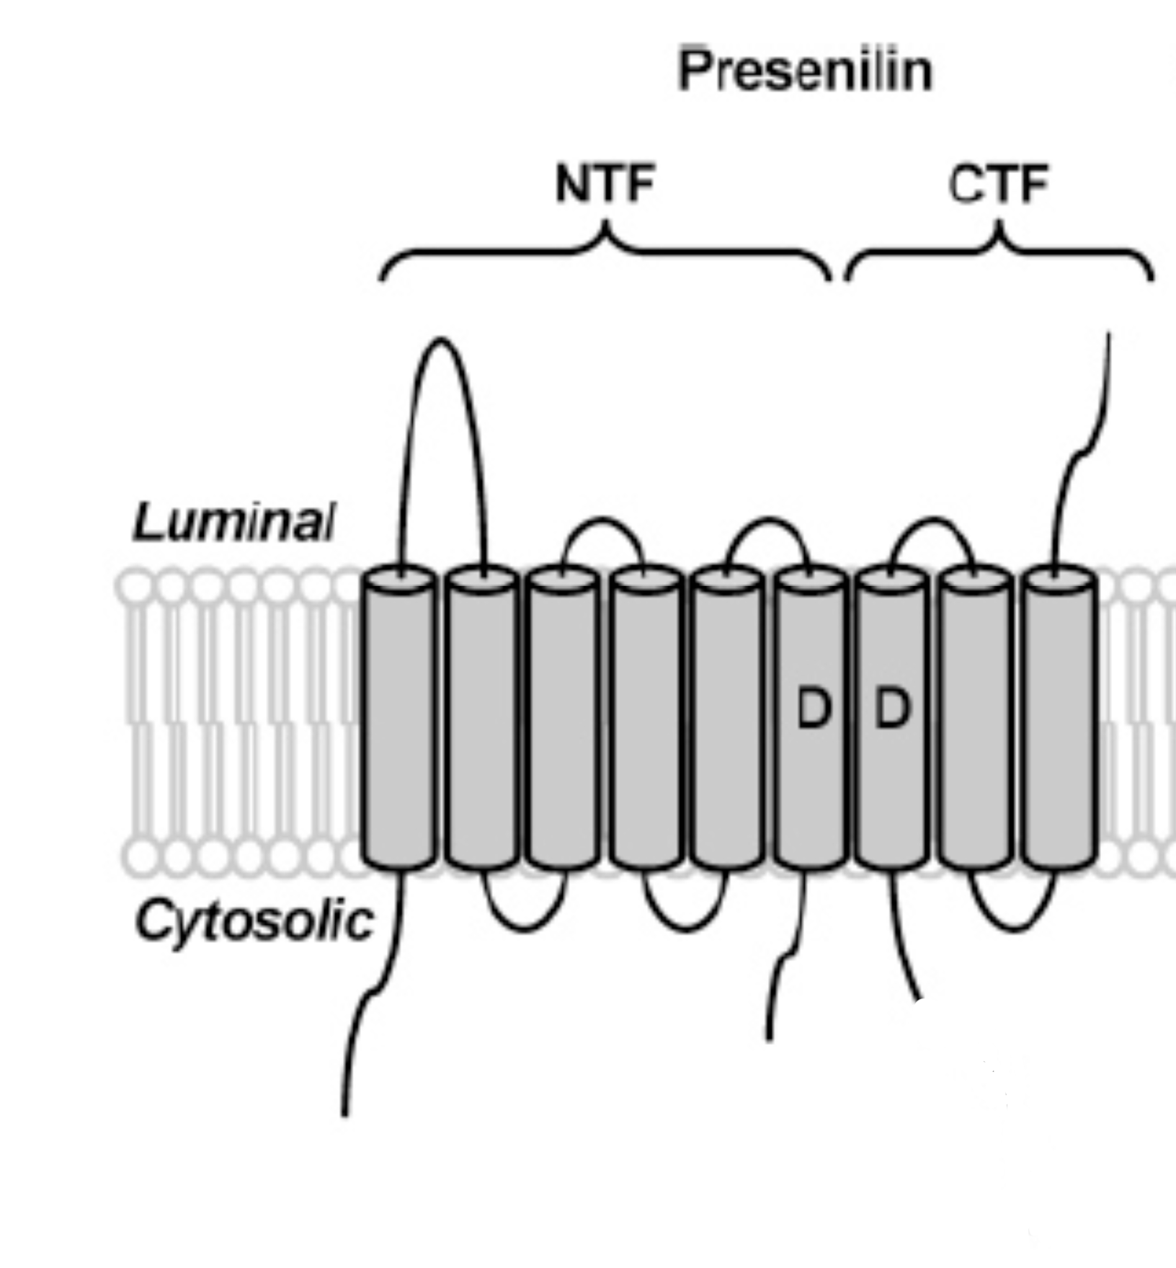
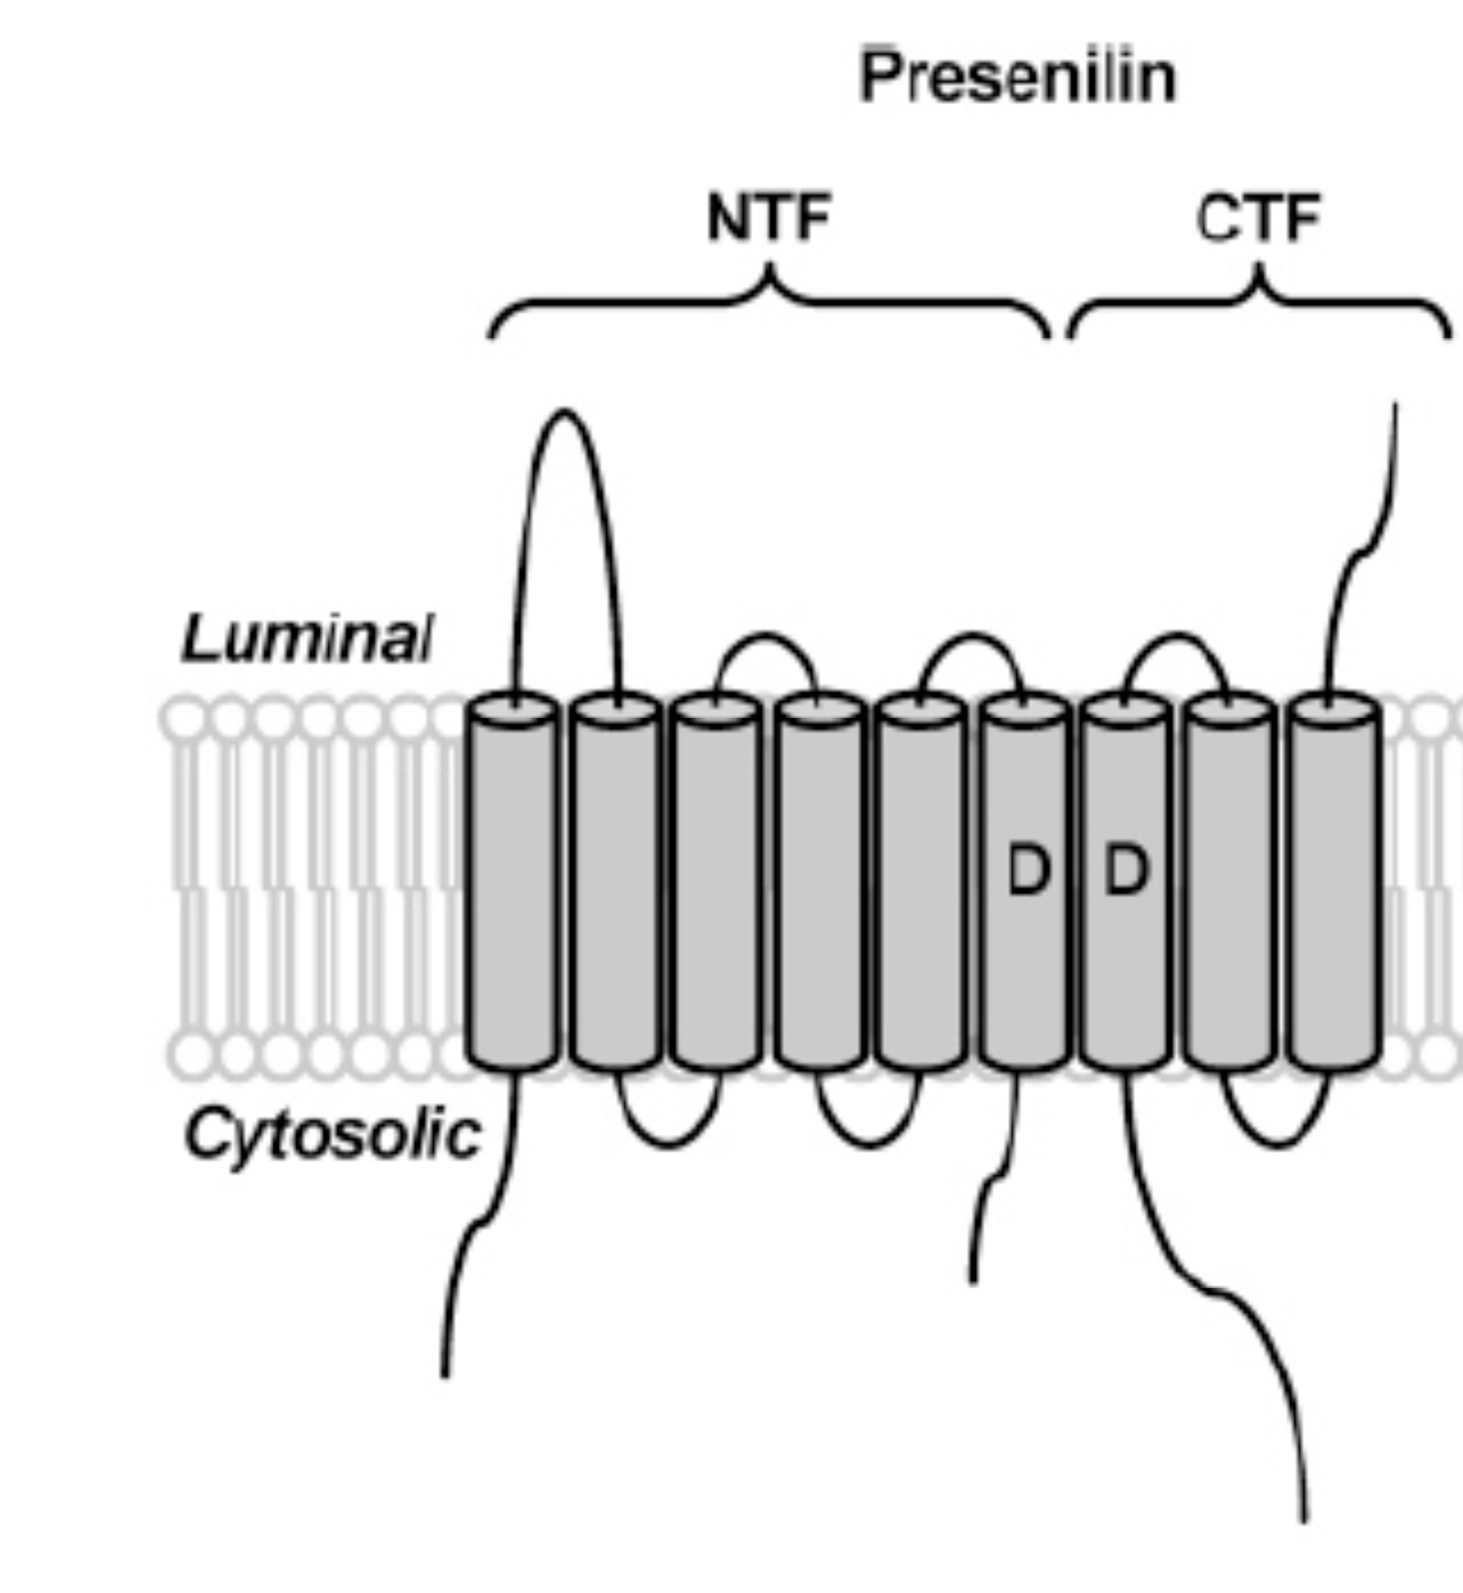
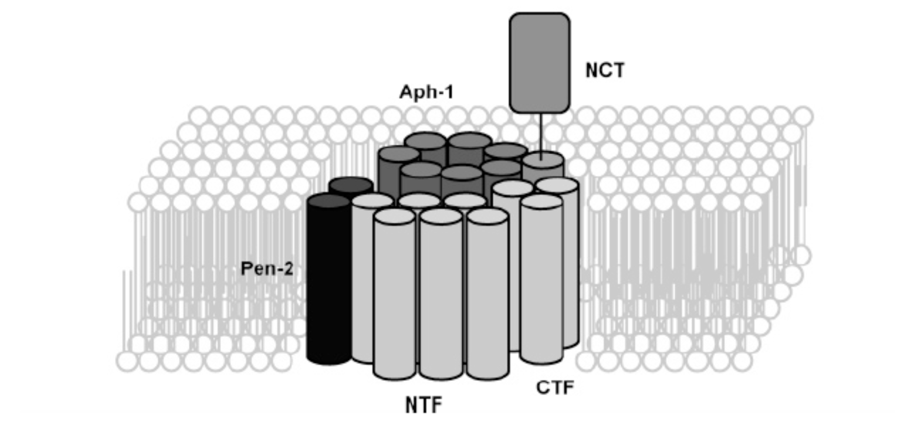
Presenilin: an active heterodimer in the γ-secretase complex
The Regulated Intramembrane Proteolysis
Loop domain
Loop domain
Endoproteolysis
H2O, substrates
Modified from Michael Wolfe

Slide 18
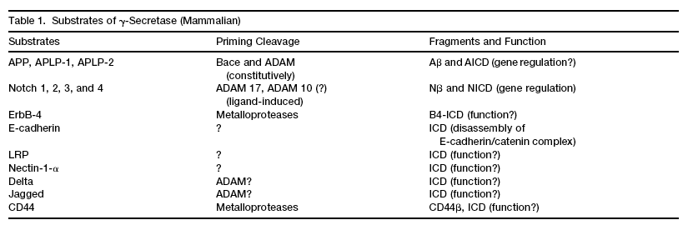
γ-secretase cleaves different substrates
Bart De Strooper

Slide 19
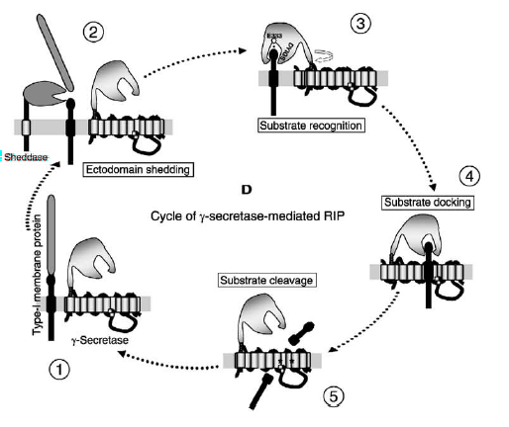
Mechanism by which Nicastrin participates in the “Regulated Intracellular Proteolysis” RIP
BACE
β-secretase
Steps:
1-The substrates gets in close proximity with the γ-secretase complex (i.e. after internalization from the plasma membrane).
2-Nicastrin specifically recognizes the substrate, and binds to it.
3-Presenilin (PS1) cuts the substrate within the exposed sequence (in the case of APP will be the Aβ sequence).
Shah et al.,

